Slide 1
Development of Auburn Educational Data Intelligence System (AEDIS) : AuTOMATIC REPORT GENERATION LAYER
Presented by : Jeronime A. Houndonougbo, AKA ”Aubie”
Supervised by: Pr. Xiao Qin, Director of Graduate Programs

Slide 2
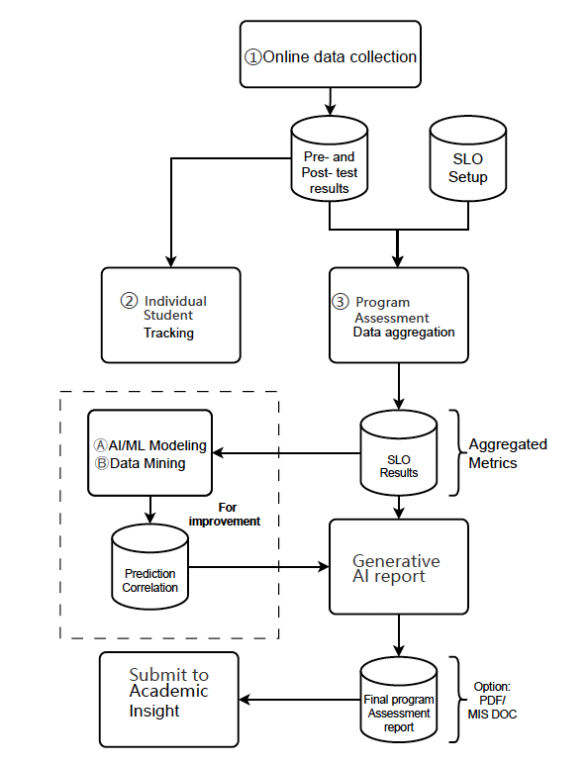
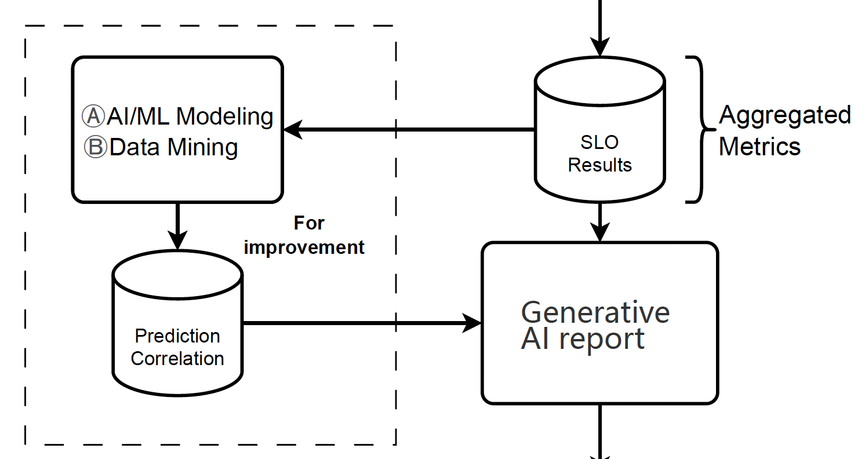
Auburn Educational Data Intelligence System (AEDIS)
Automatic REPORT GENERATION LAYER : DATA FLOW DIAGRAM

Slide 3
Auburn Educational Data Intelligence System (AEDIS)
Automatic REPORT GENERATION LAYER : SUMMARY
Main Goal (from the proposal) : Automatic reports generated through GenAI technique/ML algorigthms – From the SLO
Results as the main input.
Suggestions :
Use of a Vector DB (to store the SLOs results of each degree as vectors with multidimensions).
Use of the RAG Architecture (Retrieval Augmented Generation) + AI for the automatic generation (prompt).
Caveats :
Difficulty to store the past reports also as “Vectors” in a Vector DB.
Biases in the results & complexity of the AEDIS Architecture : every new generation of a report in the system
should be linked to (at least): a particular degree + a particular year + a past report/a valid template.
In addition, not all the students take the same optional courses in the curriculum for a given degree!
Report Generation Pipeline : The pipeline designed has three (3) main layers :
Layer 1: Report Generation + SLOs results insertion in the vector DB (optional)
Layer 2: Action Plan inclusion and finetuning + gradebook specific tables
Layer 3: Trend Analysis

Slide 4
Auburn Educational Data Intelligence System (AEDIS)
Automatic REPORT GENERATION LAYER : PIPELINE ARCHITECTURE
Past Reports
(filename, degree_name, content)
RAG + Gemini AI / Python = Report generated
2
Input : file path (url) + degree + year
*File path : Gsheet url file (Google AI Studio API)
& Google Cloud
*Gsheet : Fixed template with a fixed structure/table
Report Template
(filename, generic_content)
1
Grades – curriculum_map – SLO_scores
Process running :
Check connection to gsheet (through AI)
Extract the 3 tables from the gradebook file
Check connection to MongoDB
R : Rubric PDF (context) + step 1 & 2
A : Gemini/RAG + step 3
G : Write into the report file (1) with Action Plan
[Layer 1 & 2]
Layer 3/Trend Analysis : overall trend/prediction/
correlation
> MongoDB – NoSQL (Doc DB)
D | Y | SLO1 | SLO2 | SLO3 | SLO4
SLO Results of Degree A / Year X
SLO Results of Degree A / Year Y
History of the SLO Results
from past reports
Per degree/per year
New record of SLOs vectors
From a new gradebook input
(Excel file)
3
> Milvus – NoSQL (Vect DB)

Slide 5
Auburn Educational Data Intelligence System (AEDIS)
Automatic REPORT GENERATION LAYER : DEMO
Please access the video of the demo on the sharepoint through this following link :
https://tigermailauburn-my.sharepoint.com/:p:/g/personal/jah0268_auburn_edu/EVt8jB-MFHxIqDmmitAvcogBhxke8S1QrS1ibx9hoAinvA?e=Vbi5SB

Slide 6
Auburn Educational Data Intelligence System (AEDIS)
Automatic REPORT GENERATION LAYER
THANK YOU!
Questions ?

